Slide 1
Sample Dashboard
File created on: 27/07/23 8:52:28 pm IST

Slide 2
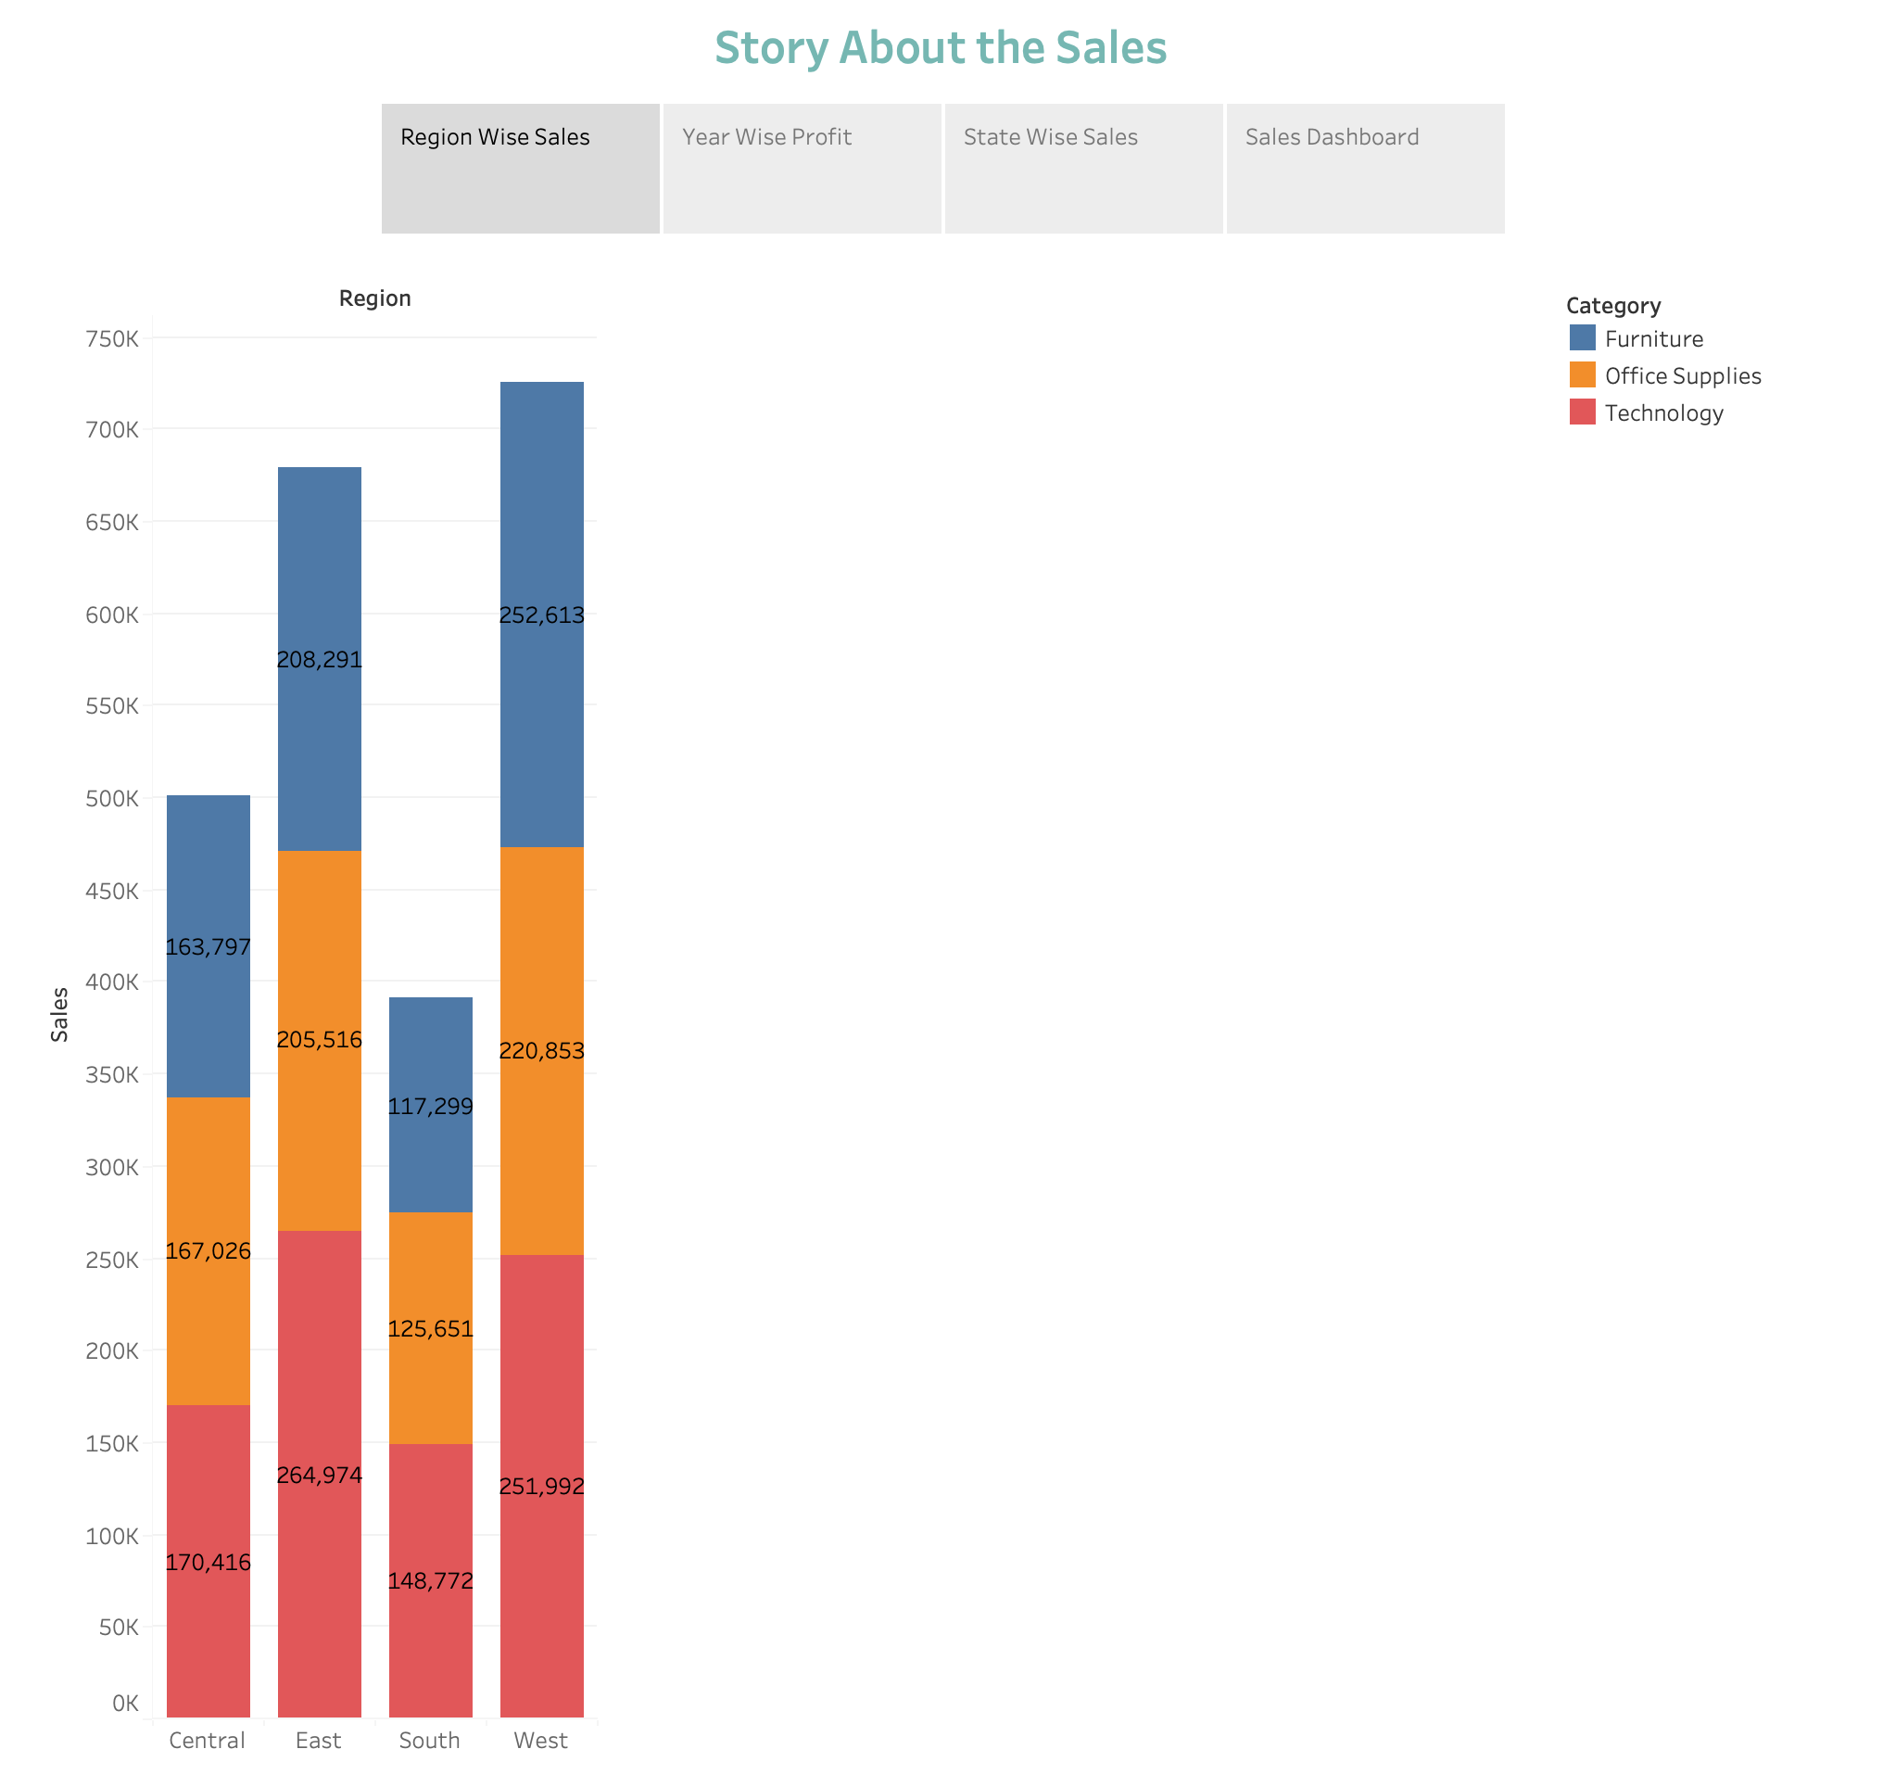

Slide 3
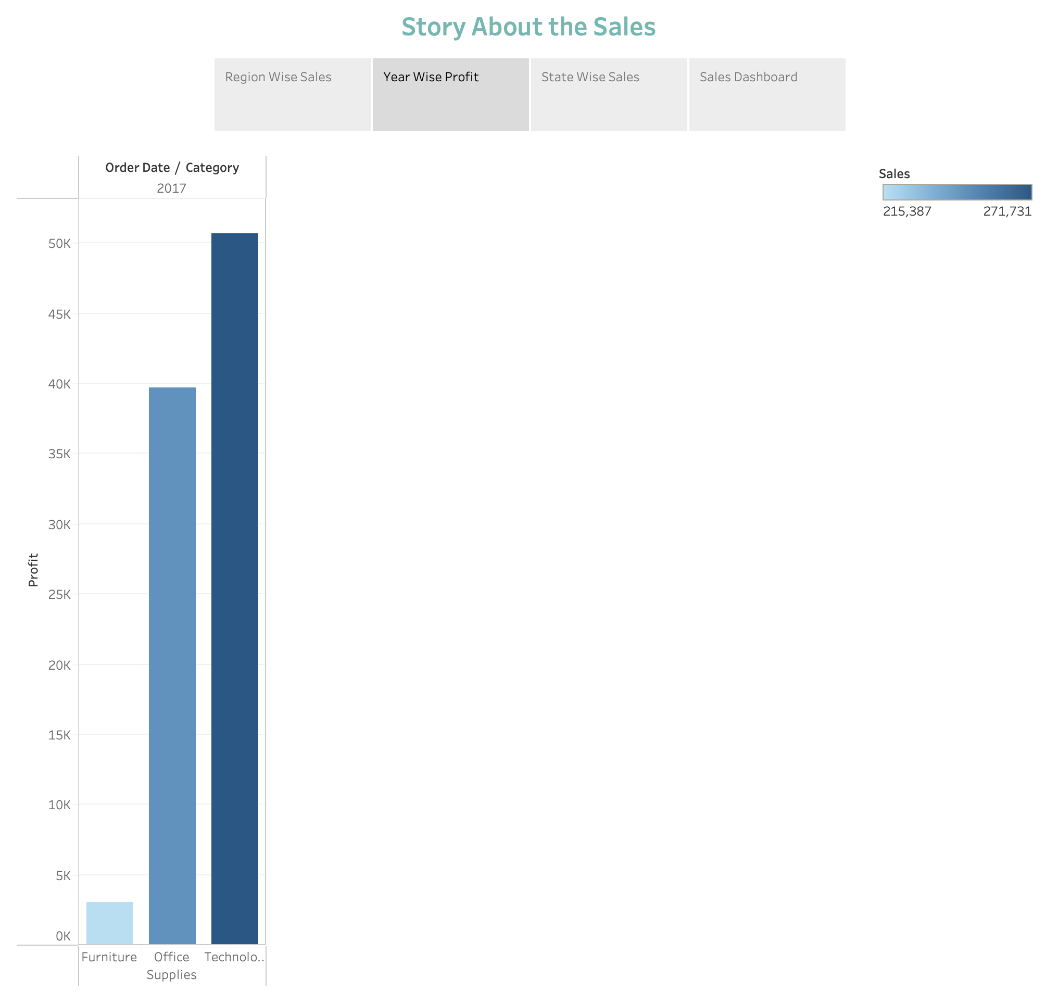

Slide 4
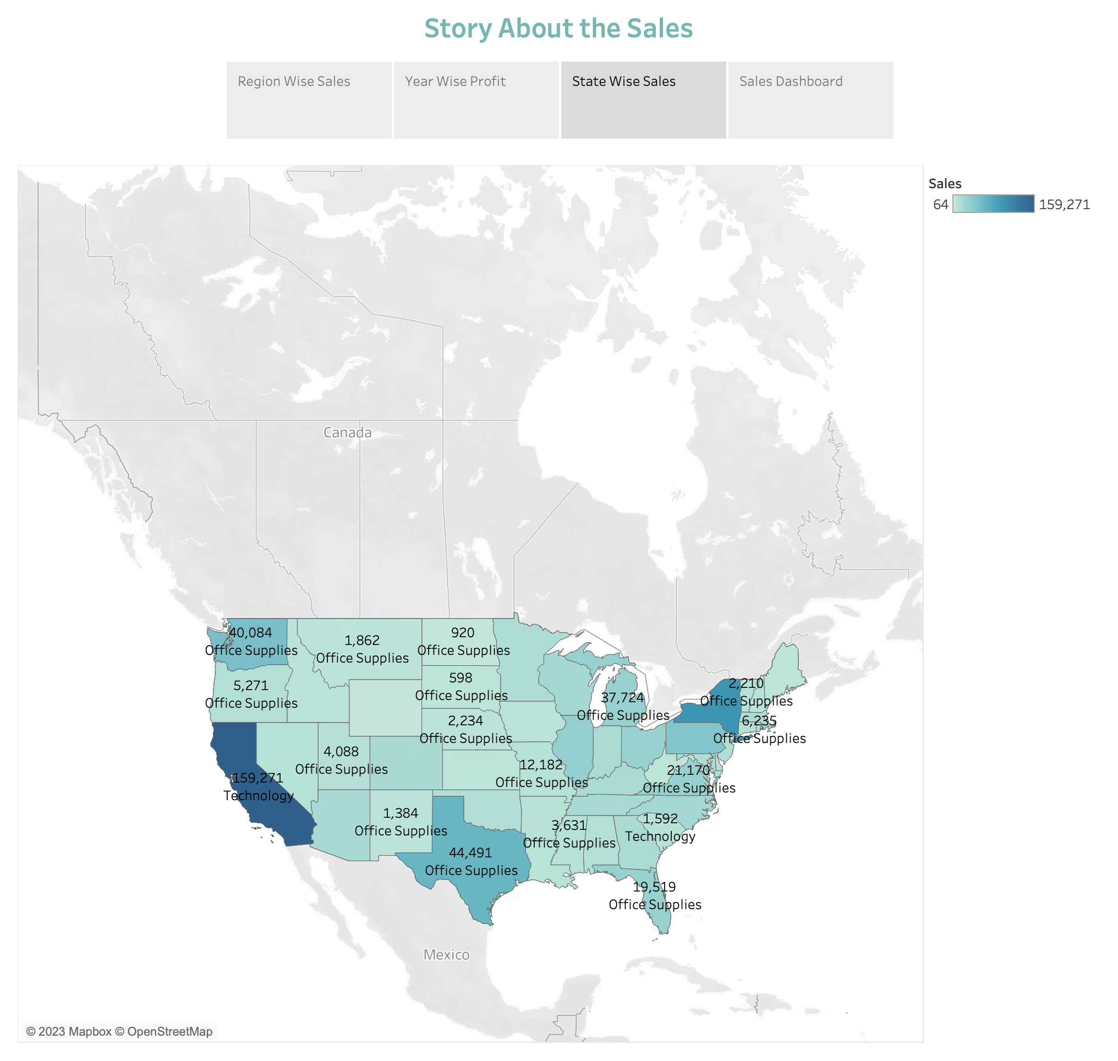

Slide 5
